Slide 1

Al Zaytounah for Home & Office Supplies
Cool Gear Catalogue - 2025

Slide 2
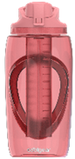
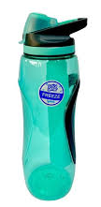
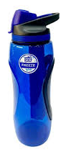
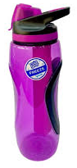

Water Bottles
Item Code: CG-1769-BE --- Item Desc: WaterBtl 32 OZ GRAVITY W/FREEZER STICK BLUE
Item Code: CG-1769-PE --- Item Desc: WaterBtl 32 OZ GRAVITY W/FREEZER STICK PURPLE
Item Code: CG-1769-TE --- Item Desc: WaterBtl 32 OZ GRAVITY W/FREEZER STICK TEAL
Item Code: CG-1769-PK --- Item Dec: WaterBtl 32 OZ GRAVITY W/FREEZER STICK PINK
VAT: 16%
RP: 12.25 JD’s (inc VAT)

Slide 3
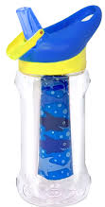
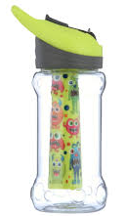
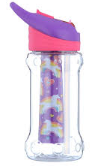
Water Bottles
Item Code: CG-2082-BE-2 --- Item Desc: WaterBtl 14 OZ PALOMA / Blue Sharks
Item Code: CG-2082-GN-2--- Item Desc: WaterBtl 14 OZ PALOMA / Green Monster
Item Code: CG-2082-PK-2 --- Item Desc: WaterBtl 14 OZ PALOMA / Pink Unicorn
VAT: 16%
RP: 7.00 JD’s (inc VAT)

Slide 4

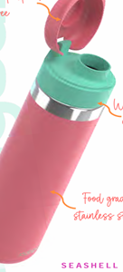
Water Bottles
Item Code: CG-4843-BE --- Item Desc: CG WaterBottle Stainless Bliss 25oz Blue
Item Code: CG-4843-PK --- Item Desc: CG WaterBottle Stainless Bliss 25oz Pink
VAT: 16%
RP: 10.50 (Inc VAT)

Slide 5
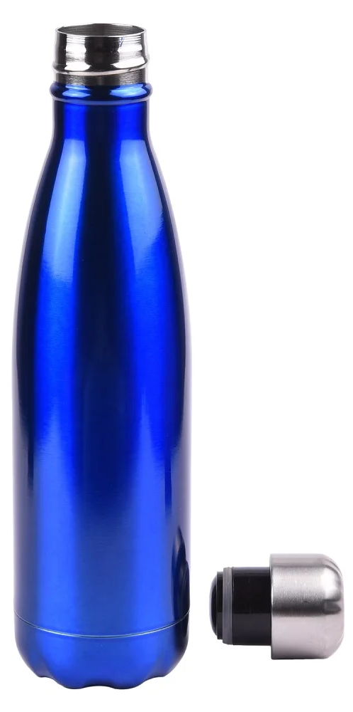
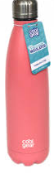
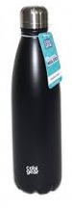
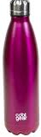
Water Bottles
Item Code: CG-4845-BE --- Item Desc: WaterBtl Stainless Steel Blue 0.7 L
Item Code: CG-4845-BK --- Item Desc: WaterBtl Stainless Steel Black 0.7 L
Item Code: CG-4845-PE --- Item Desc: WaterBtl Stainless Steel Purple 0.7 L
Item Code: CG-4845-PK --- Item Desc: WaterBtl Stainless Steel Pink 0.7 L
VAT: 16%
RP: 14.00 JD’s (inc VAT)

Slide 6
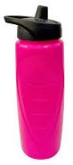
Water Bottles
Item Code: CG-4932-PK-2 --- Item Desc: WaterBtl 28 OZ CONTOUR SQZ / PINK
VAT: 16%
RP: 3.50 JD’s (inc VAT)

Slide 7
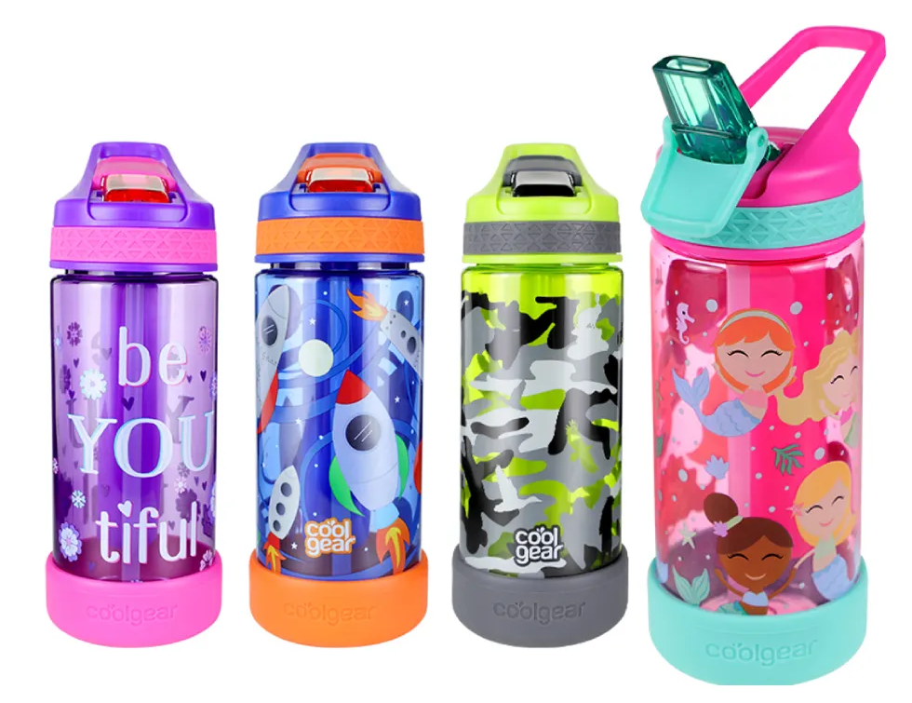
Water Bottles
Item Code: CG-5414-BE --- Item Desc: WaterBtl 16 OZ SPROUT | GRAPHICS Blue
Item Code: CG-5414-GN --- Item Desc: WaterBtl 16 OZ SPROUT | GRAPHICS Green
Item Code: CG-5414-PE --- Item Desc: WaterBtl 16 OZ SPROUT | GRAPHICS Purple
Item Code: CG-5414-PK --- Item Desc: WaterBtl 16 OZ SPROUT | GRAPHICS PINK
VAT: 16%
RP: 6.50 JD’s (inc VAT)

Slide 8
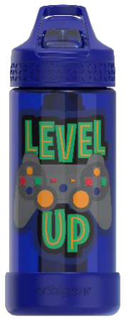
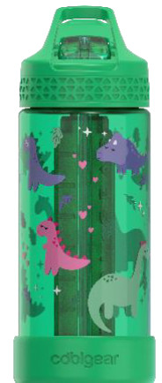
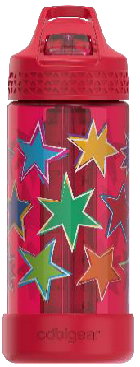
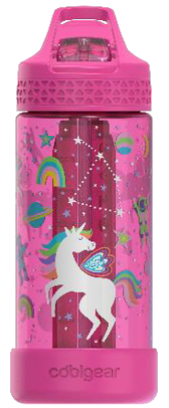
Water Bottles
Item Code: CG-5415-BE --- Item Desc: WaterBtl 16 OZ SYSTEM KIDS - GAME
Item Code: CG-5415-GN --- Item Desc: WaterBtl 16 OZ SYSTEM KIDS - DINOS
Item Code: CG-5415-PK --- Item Desc: WaterBtl 16 OZ SYSTEM KIDS - UNICORN
Item Code: CG-5415-RD --- Item Desc: WaterBtl 16 OZ SYSTEM KIDS - STARS
VAT: 16%
RP: 6.50 JD’s (inc VAT)

Slide 9
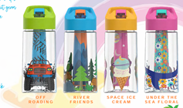
Water Bottles
Item Code: CG-5416-GN --- Item Desc: CG WaterBottle Taper 14oz Green
Item Code: CG-5416-BE --- Item Desc: CG WaterBottle Taper 14oz Blue
Item Code: CG-5416-OE --- Item Desc: CG WaterBottle Taper 14oz Orange
Item Code: CG-5416-PK --- Item Desc: CG WaterBottle Taper 14oz Pink
VAT: 16%
RP: 6.50 (Inc VAT)

Slide 10
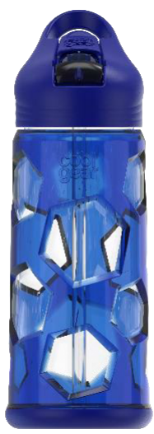
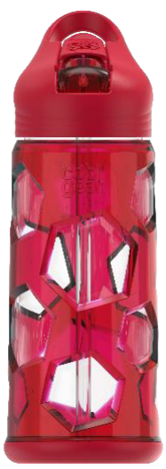
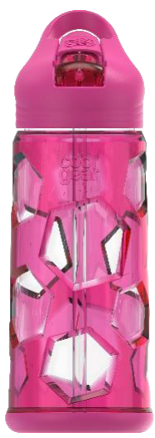
Water Bottles
Item Code: CG-7568-BE-2 --- Item Desc: WaterBtl 16 OZ HEXAGON CAGE / BLUE
Item Code: CG-7568-RD-2 --- Item Desc: WaterBtl 16 OZ HEXAGON CAGE / RED
Item Code: CG-7568-PK-2 --- Item Desc: WaterBtl 16 OZ HEXAGON CAGE / PINK
VAT: 16%
RP: 8.00 JD’s (inc VAT)

Slide 11
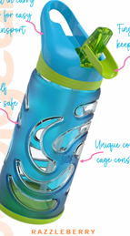

Water Bottles
Item Code: CG-7569-BE --- Item Desc: WaterBtl 16 OZ CIRCLES / BLUE
Item Code: CG-7569-PK --- Item Desc: WaterBtl 16 OZ CIRCLES / RED
VAT: 16%
RP: 8.00 (Inc VAT)

Slide 12
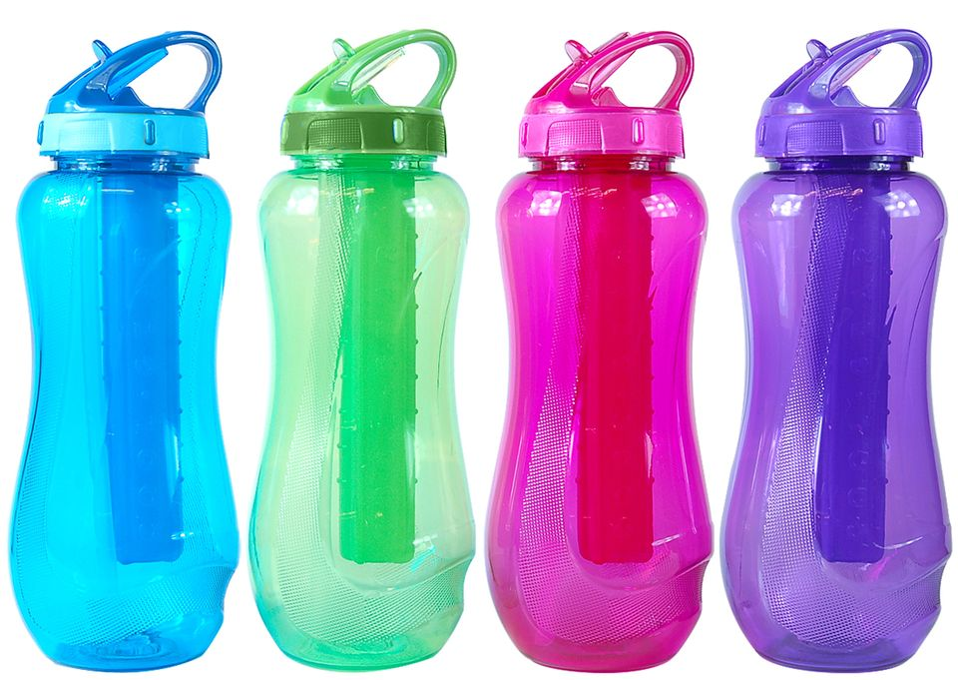
Water Bottles
Item Code: CG-765-BE --- Item Desc: WaterBtl HORIZON Blue 0.65 L
Item Code: CG-765-GN --- Item Desc: WaterBtl HORIZON Green 0.65 L
Item Code: CG-765-PE --- Item Desc: WaterBtl HORIZON Purple 0.65 L
Item Code: CG-765-PK --- Item Desc: WaterBtl HORIZON Pink 0.65 L
VAT: 16%
RP: 7.25 JD’s (inc VAT)

Slide 13
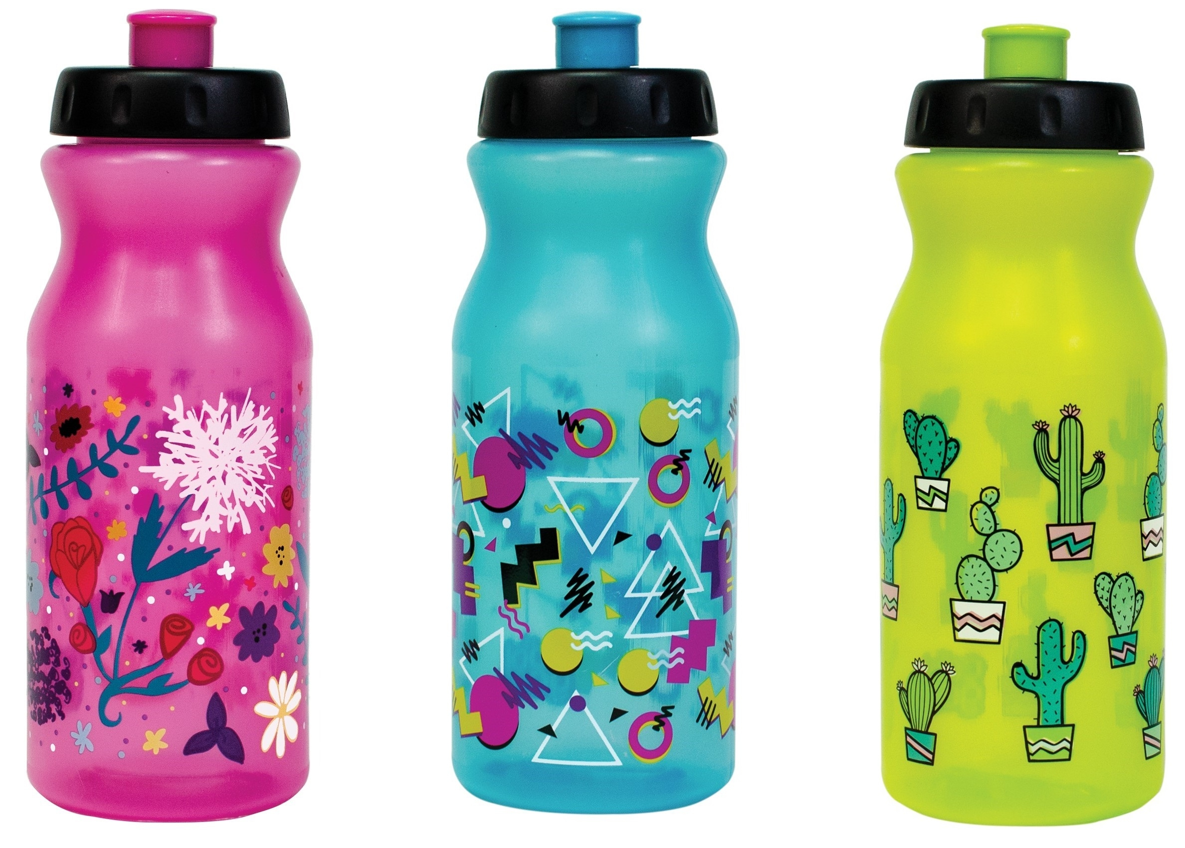
Water Bottles
Item Code: CG-7666-BE --- Item Desc: WaterBtl 22 OZ Reform Bottle W/ Graphics & FS BLUE
Item Code: CG-7666-LG --- Item Desc: WaterBtl 22 OZ Reform Bottle W/ Graphics &FS Green
Item Code: CG-7666-PK --- Item Desc: WaterBtl 22 OZ Reform Bottle W/ Graphics & FS PINK
VAT: 16%
RP: 3.50 JD’s (inc VAT)

Slide 14
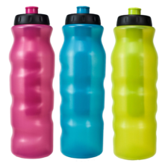
Water Bottles
Item Code: CG-7667-BE --- Item Desc: WaterBtl REFORMSQUEEZE Blue 0.9 L
Item Code: CG-7667-GN --- Item Desc: WaterBtl REFORMSQUEEZE Green 0.9 L
Item Code: CG-7667-PK --- Item Desc: WaterBtl REFORMSQUEEZE Pink 0.9 L
VAT: 16%
RP: 4.00 JD’s (inc VAT)

Slide 15
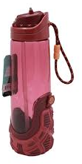
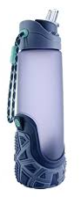
Water Bottles
Item Code: CG-Z07244-BUR --- Item Desc: WaterBtl 24 oz Adults Treadz Sipper PK Burgandy
Item Code: CG-Z07245-PE --- Item Desc: WaterBtl 24 oz Adults Treadz Sipper GY Purple
VAT: 16%
RP: 13.75 JD’s (inc VAT)

